Slide 1


“Top 5 Categories with
largest popularity ”
Data Analysis
Of
Social Buzz’s Dataset

Slide 2


Today's agenda
Project recap
Problem
The Analytics team
Process
Insights
Summary

Slide 3

Social Buzz is fastest Growing technology unicorn that need to adapt quickly to it’s global scale. Accenture has began 3 months POC focusing on these task.
An adult of social Buzz big data practice
Recommendation for a successfully IPO
Analysis to find social Buzz’s top 5 most popular categories of content.
Project Recap

Slide 4


Problem
Over 100000 posts per Day
36,500,000 pieces of content per year
But how to capitalize on it when there is so much?
Analysis to find social Buzz’s top 5 most popular categories of content.

Slide 5



Andrew Fleming (Chief Technical Architect)
The Analytics team
Marcus Romp ton (Senior Principle)
Ranjan Kumar (Data Analyst)

Slide 6
Process
1
Data Understanding
Data Cleaning
2
Data Modelling
3
4
Data Analysis
5
Uncovering Insights

Slide 7

Insights
16
1897
JANUARY
UNIQUE CATEGORIES
REACTION TO “ANIMAL” POST
MONTHS WITH MOST POSTS

Slide 8
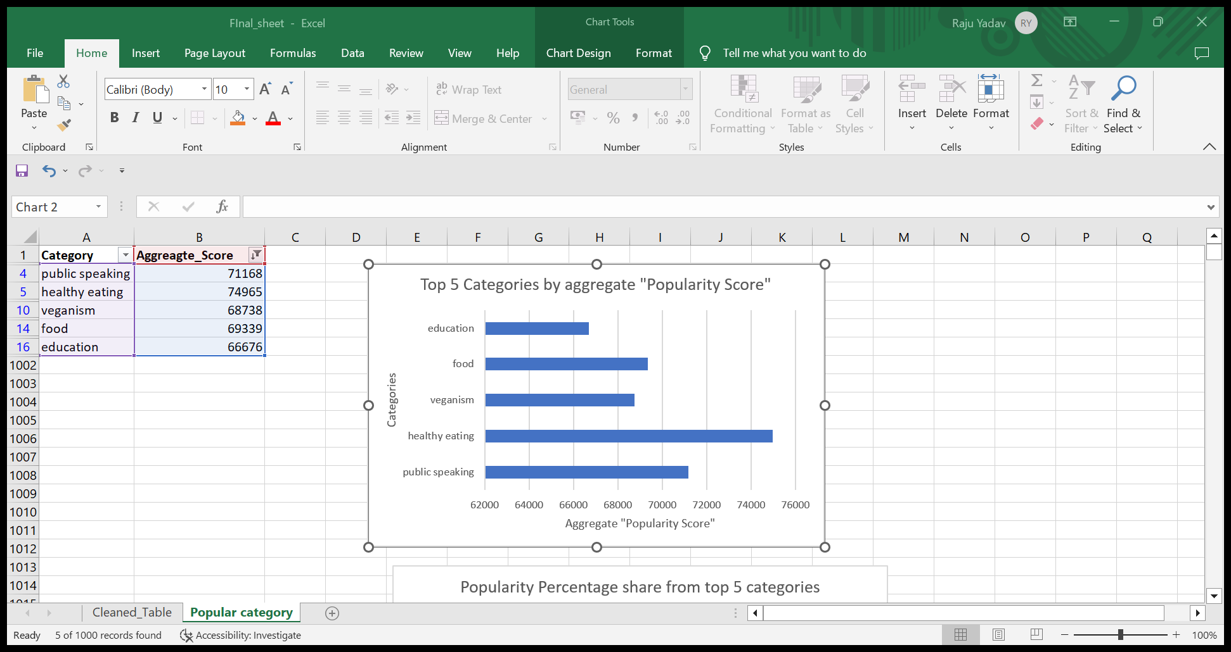
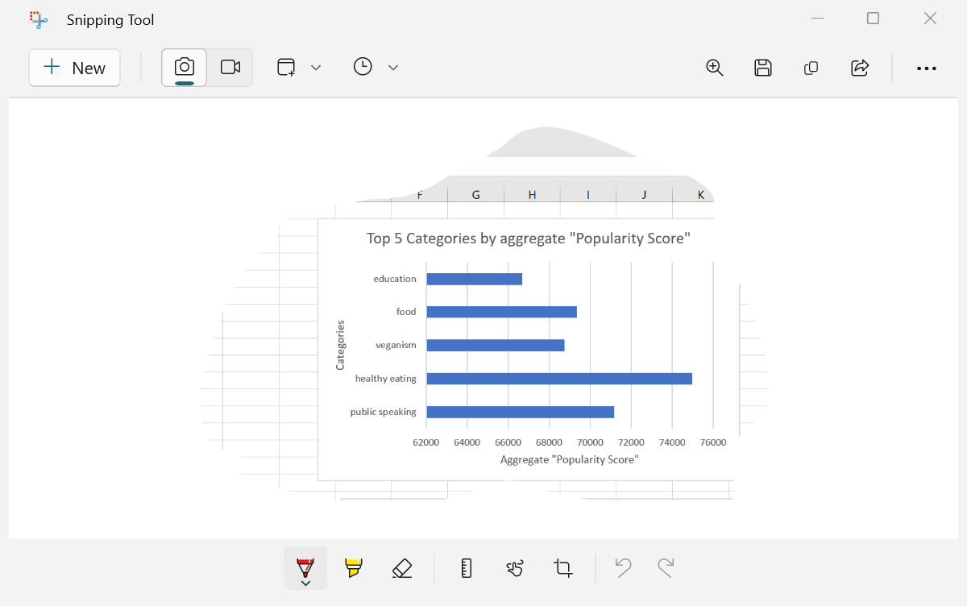

Slide 9
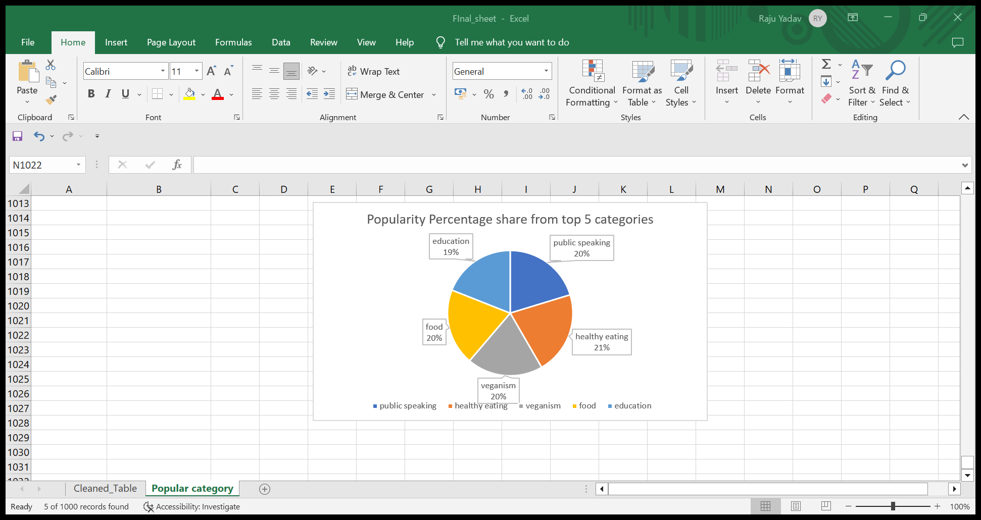

Slide 10

ANALYSIS
Animals and science are the two most popular categories of content, showing that people enjoy “real-life” and “factual” content the most.
INSIGHTS
Food is the common theme with the top 5 categories with “Healthy Eating” ranking the highest. This may give an indication to the audience within your user base. You could use this insights to create a campaign and work with healthy eating brands to boost user engagement.
NEXT STEPS
This ad-hoc analysis is insightful, but it’s time to take this analysis into large scale production for real-time understanding of your business. We can show you how to do this.
Summary

Slide 11

Thank you!
ANY QUESTIONS?

